Slide 1

Group 3(a)
Caleb Teague - Responsibilities
FM Radio
Encoder
Inertial Measurement Unit (IMU)
Triangulation
TIA
Notes:
why, how, what (and why again)

Slide 2
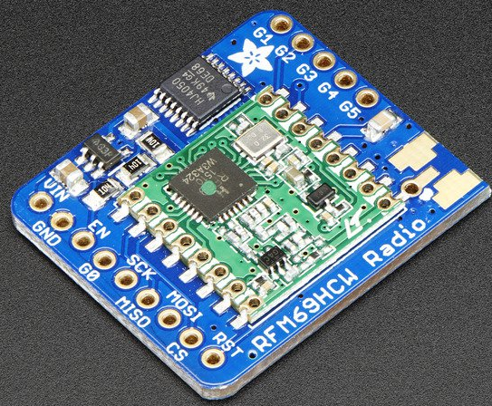
Group 3(a)
FM Radio
Spi communication
Up to 500m range
Error correction
Acknowledgement system
Pre-existing Python library

Slide 3
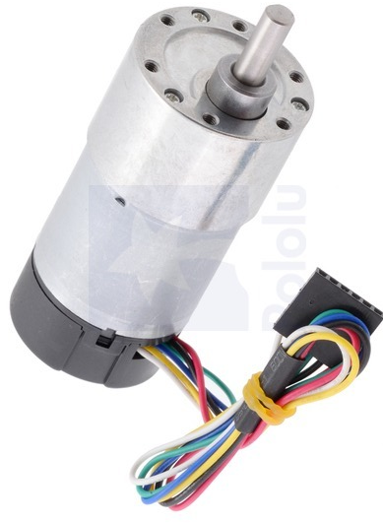
Group 3(a)
Encoder
Interrupt based encoder
3 RPM at max speed
3600 counts per revolution

Slide 4
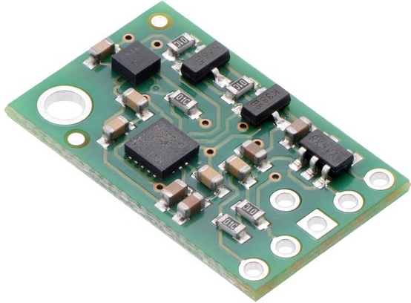
Group 3(a)
IMU
Accelerometer, Gyro, and Magnetometer
I2c communication
Complementary filter
Values update at 400Hz

Slide 5
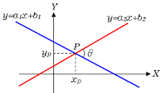
Group 3(a)
Triangulation
Matrices used for low overhead
Runs in <1 ms with 3 transponders
Corrects for limited constant errors

Slide 6
Group 3(a)
Trans-Impedance Amplifier
Highly sensitive
2us rise time
Difference amplifier

